Slide 1
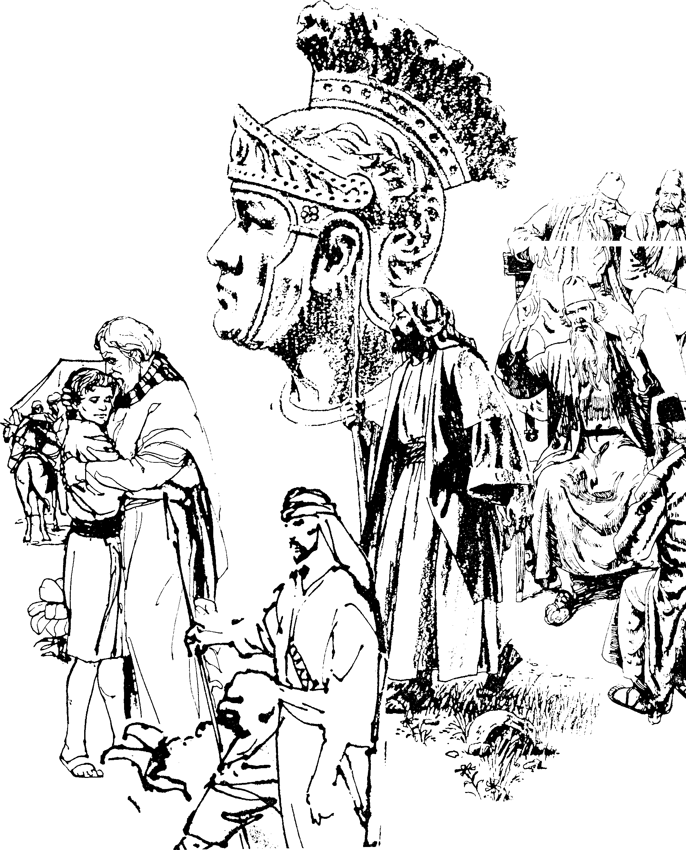
New Testament Backgrounds
Syllabus
Dr. Rick Griffith • Jordan Evangelical Theological Seminary • BibleStudyDownloads.org
Notes:
----- Meeting Notes (1/13/11 11:56) -----
Introduction slide

Slide 2

Introduce Yourself!
Name
Country
Family
Church
Class Goal
Name
Country
Programme
Family
Church
Ministry Goal
$20 each for Notes

Slide 3
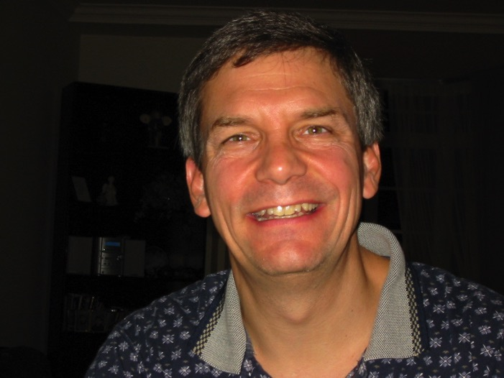

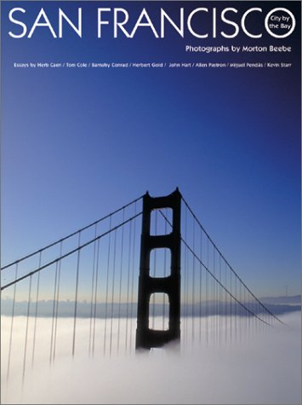
Where am I from?

Slide 4
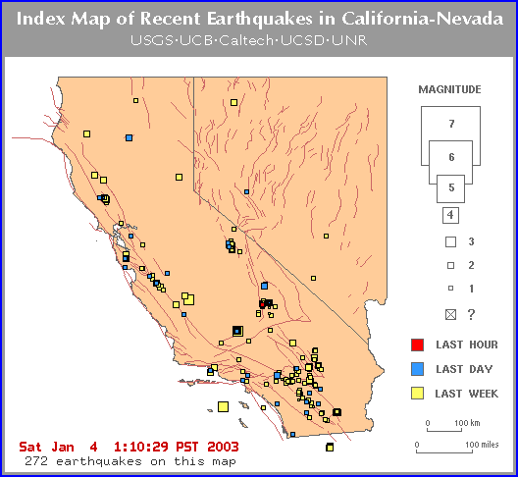
I'm from the land of quakes

Slide 5
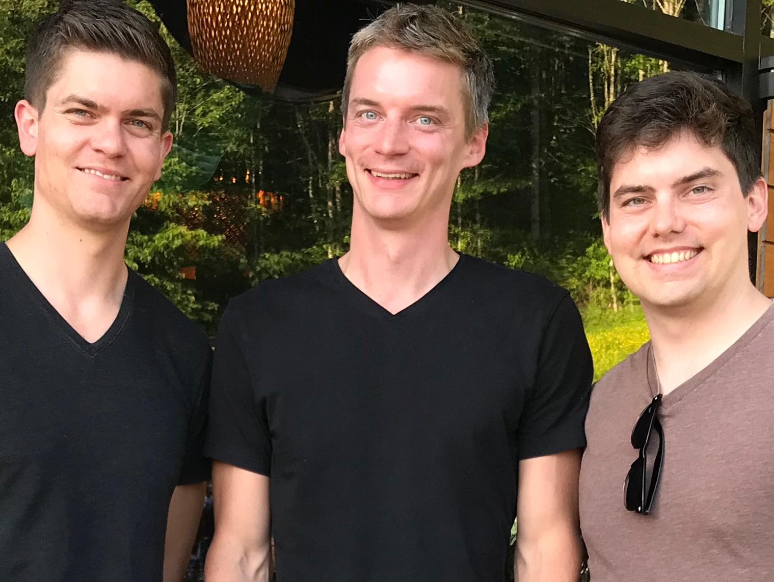
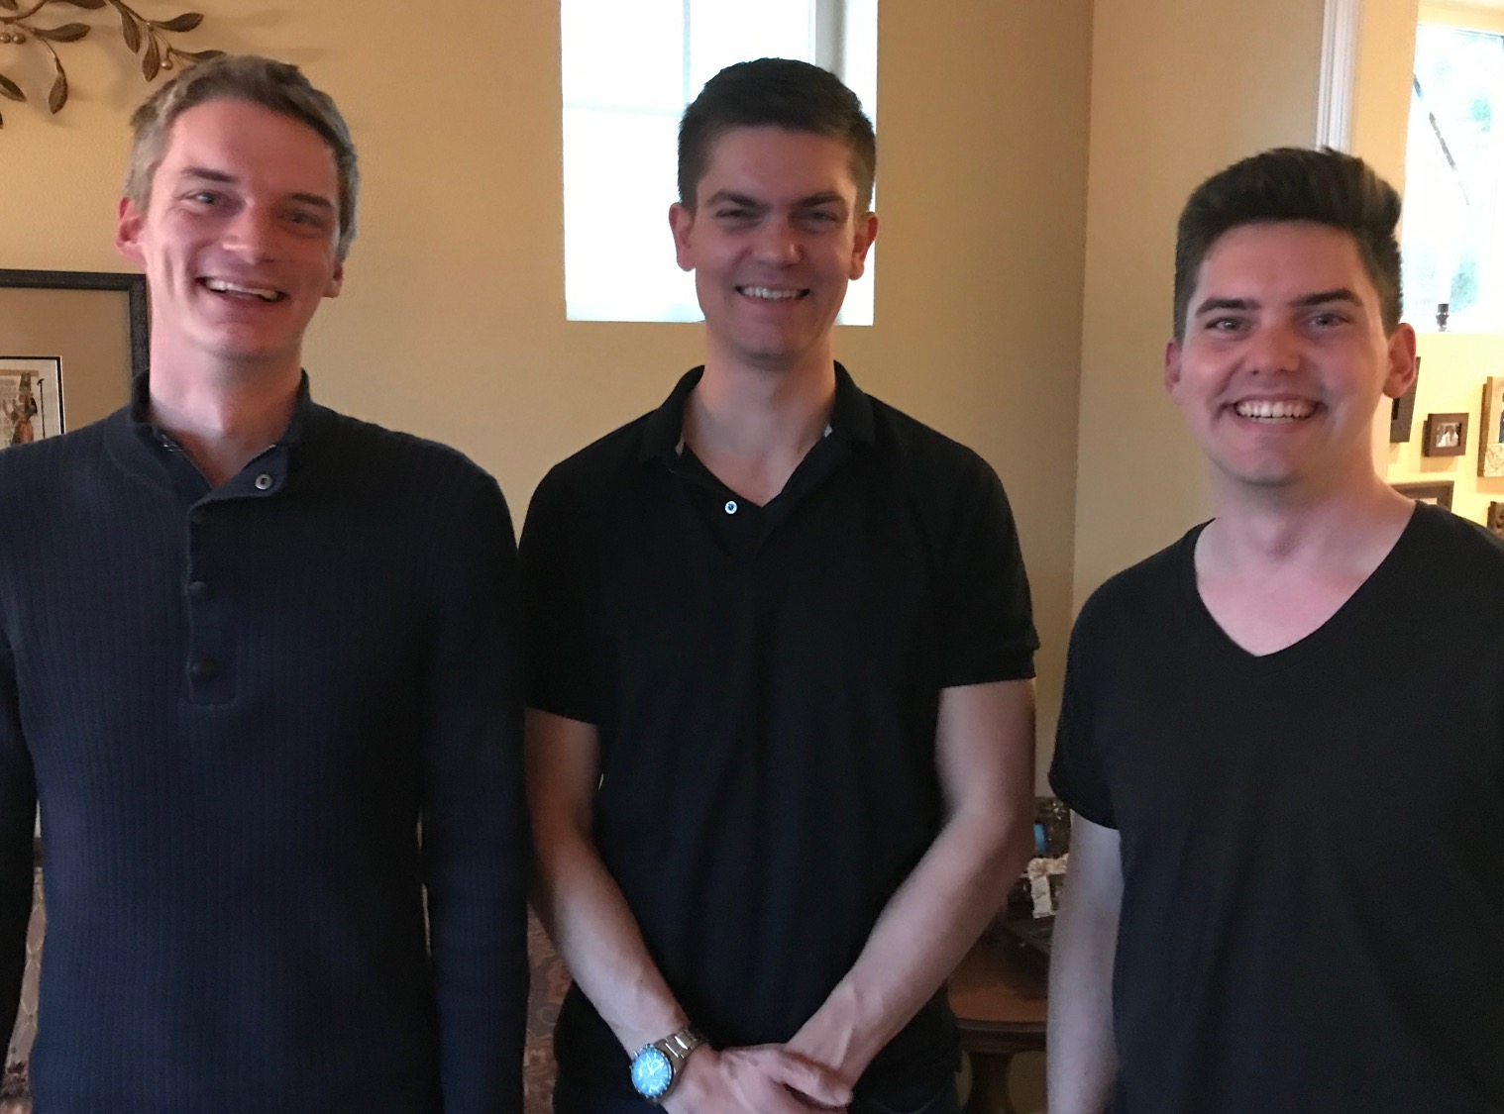
Our Three Sons

Slide 6
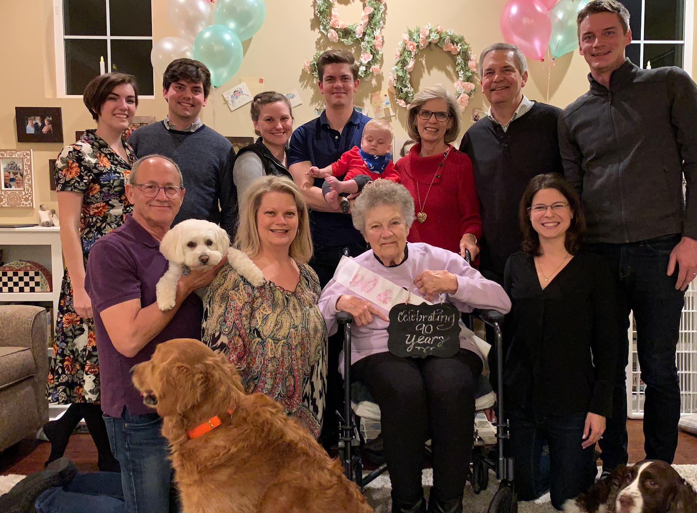
The Griffiths
28 Nov 2019
2020
Rick & Susan
John & Chloe
(29)
Kurt & Cara (35)
Stephen, Katie & Jesse (32)

Slide 7
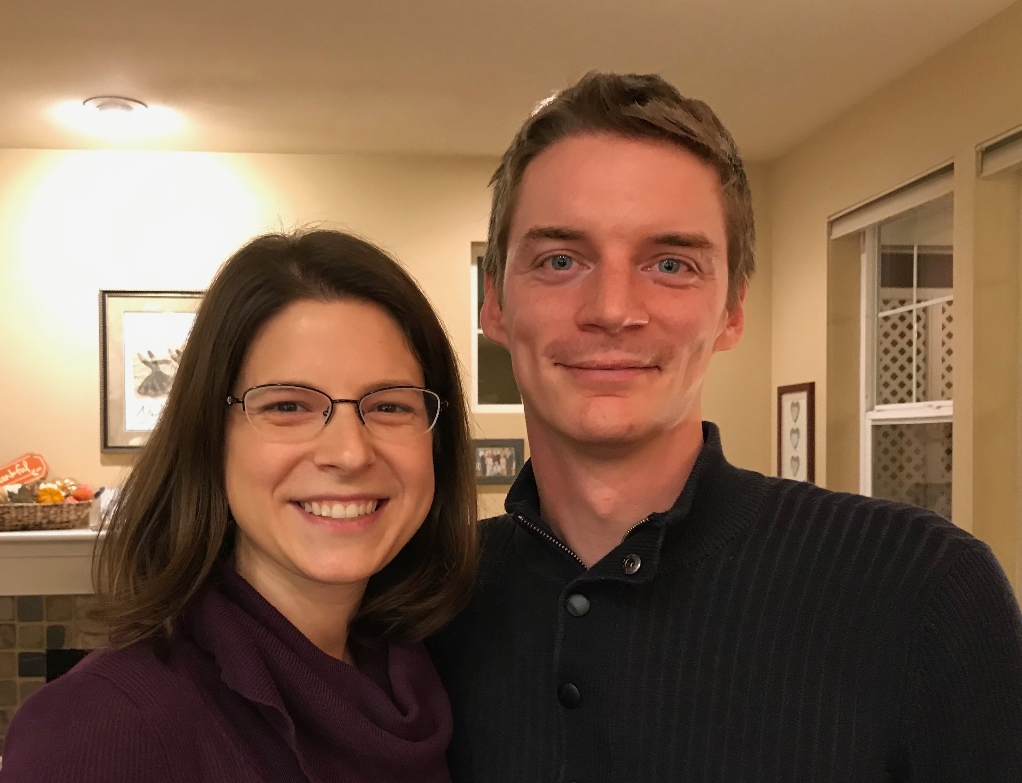
Kurt (35) & Cara own their HR consulting business near Seattle
Notes:
Kurt and his wife Cara are in Seattle

Slide 8
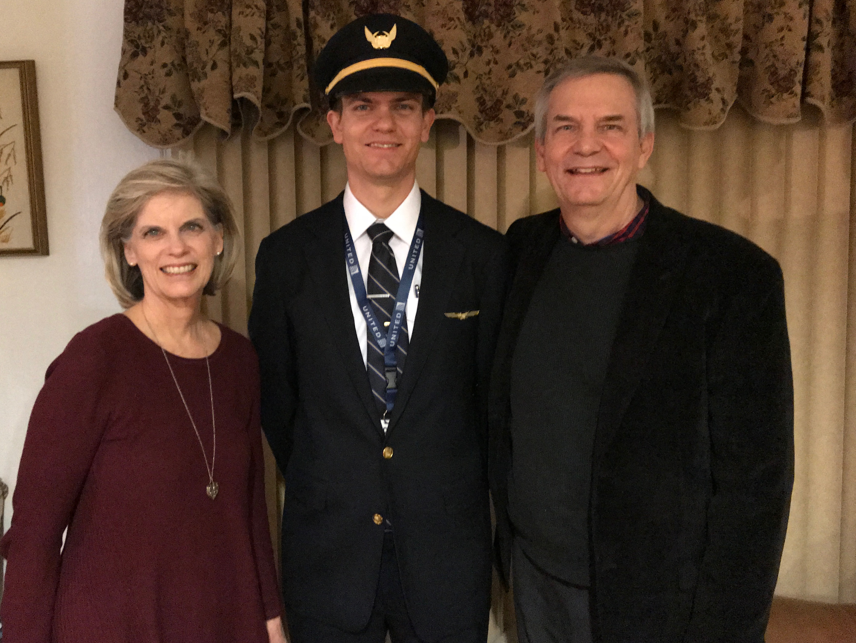

Stephen (32) trains United B777 pilots in Denver
6
Notes:
Stephen and his wife Katie in Boise

Slide 9
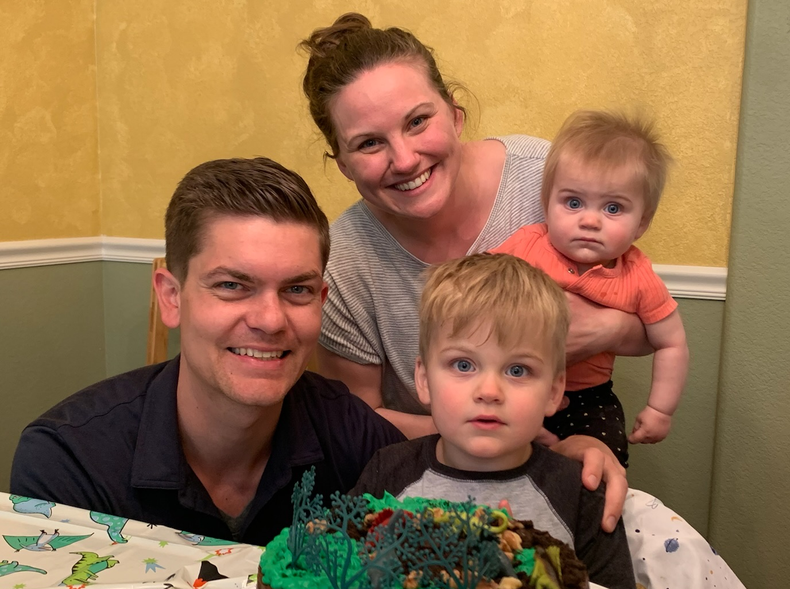
Stephen, Katie, Jesse & Norah in Denver
Notes:
Our granddaughter joined the family on 31 July 2021 but why would God take us now? I don’t know.

Slide 10
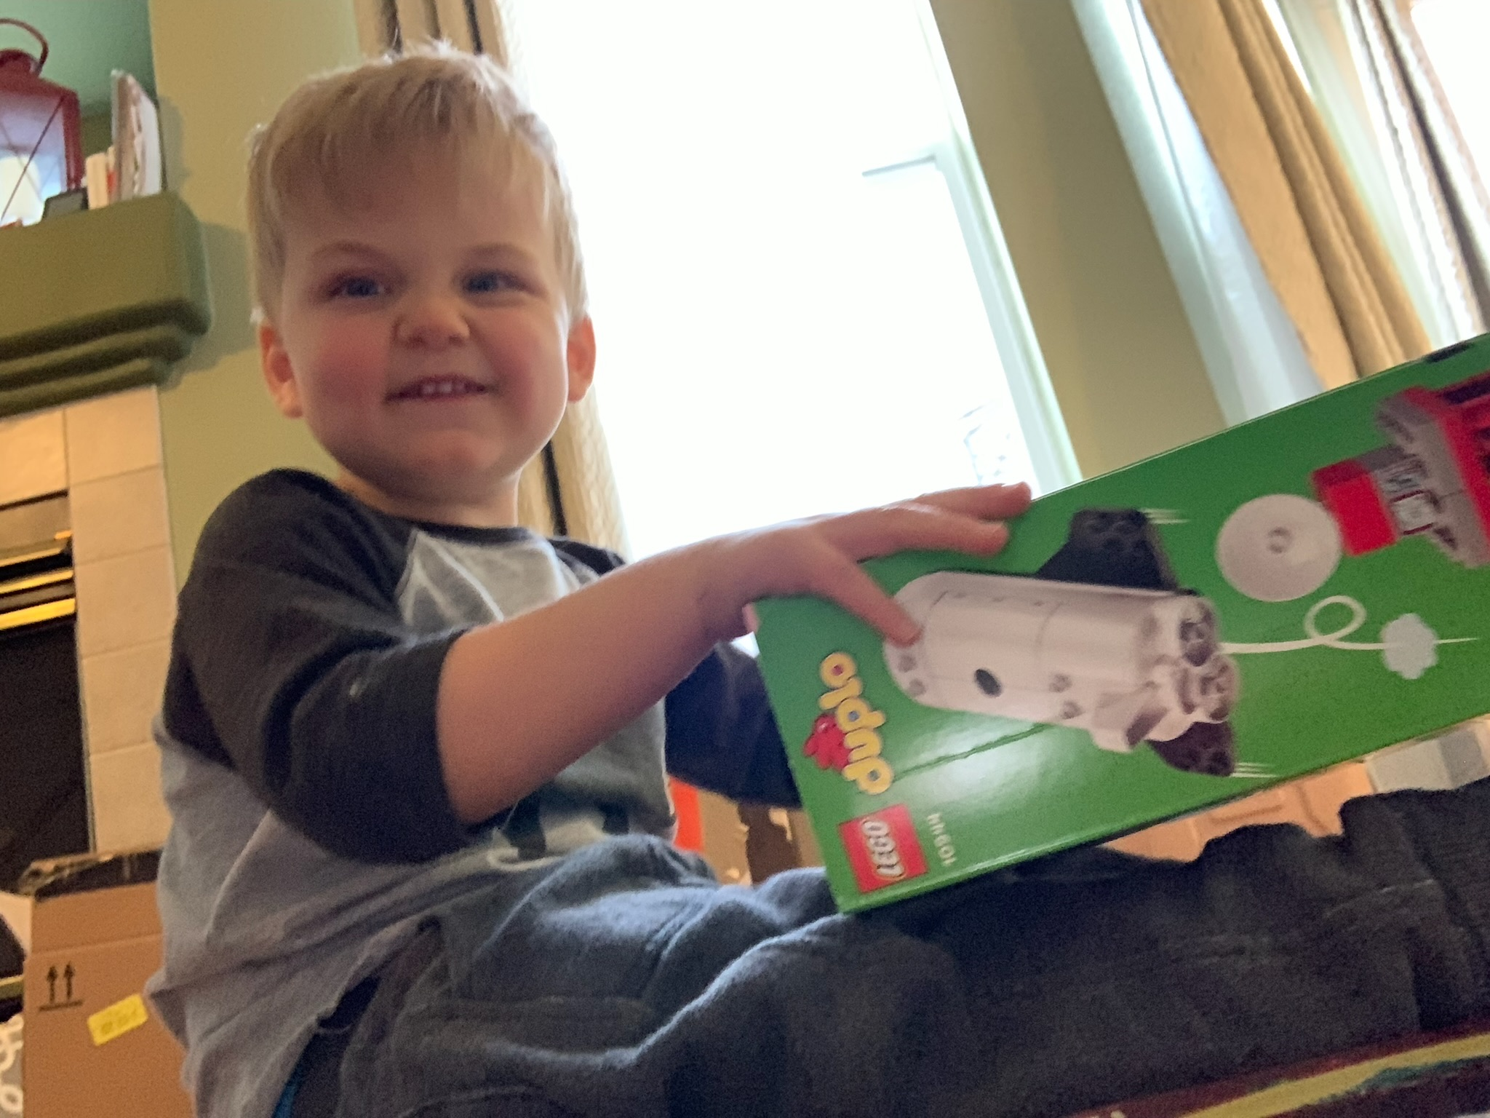
3-year-old grandson Jesse

Slide 11

1-year-old granddaughter Norah

Slide 12
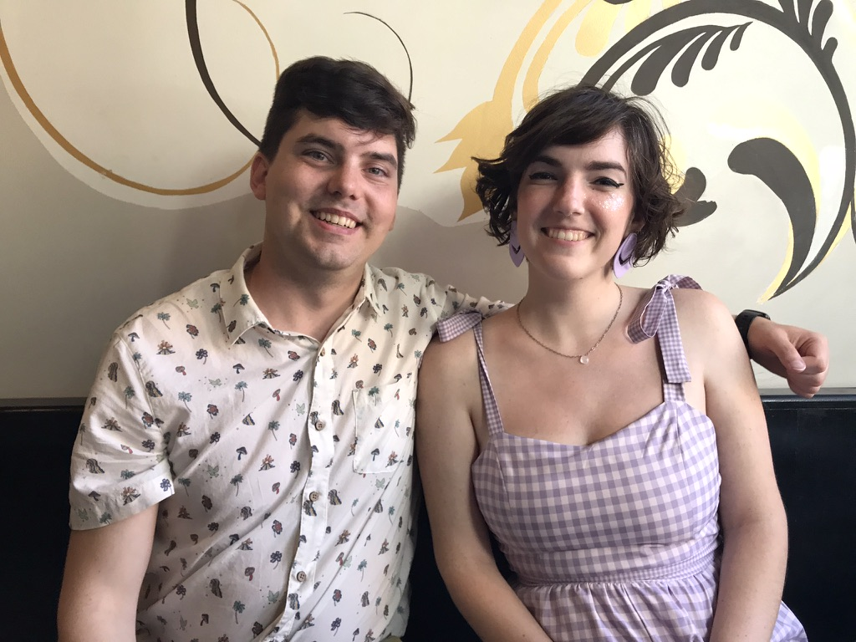
John (29) plans to marry Chloe in Pasadena, California on Nov 12
8
Notes:
John and his girlfriend Chloe both work for ESRI—Environmental Systems Research Institute—doing web design and graphics for this digital software company.

Slide 13

SINGAPORE BIBLE COLLEGE
9
Notes:
I've served as a seminary professor with 30 other faculty at Singapore's largest training school: Singapore Bible College

Slide 14
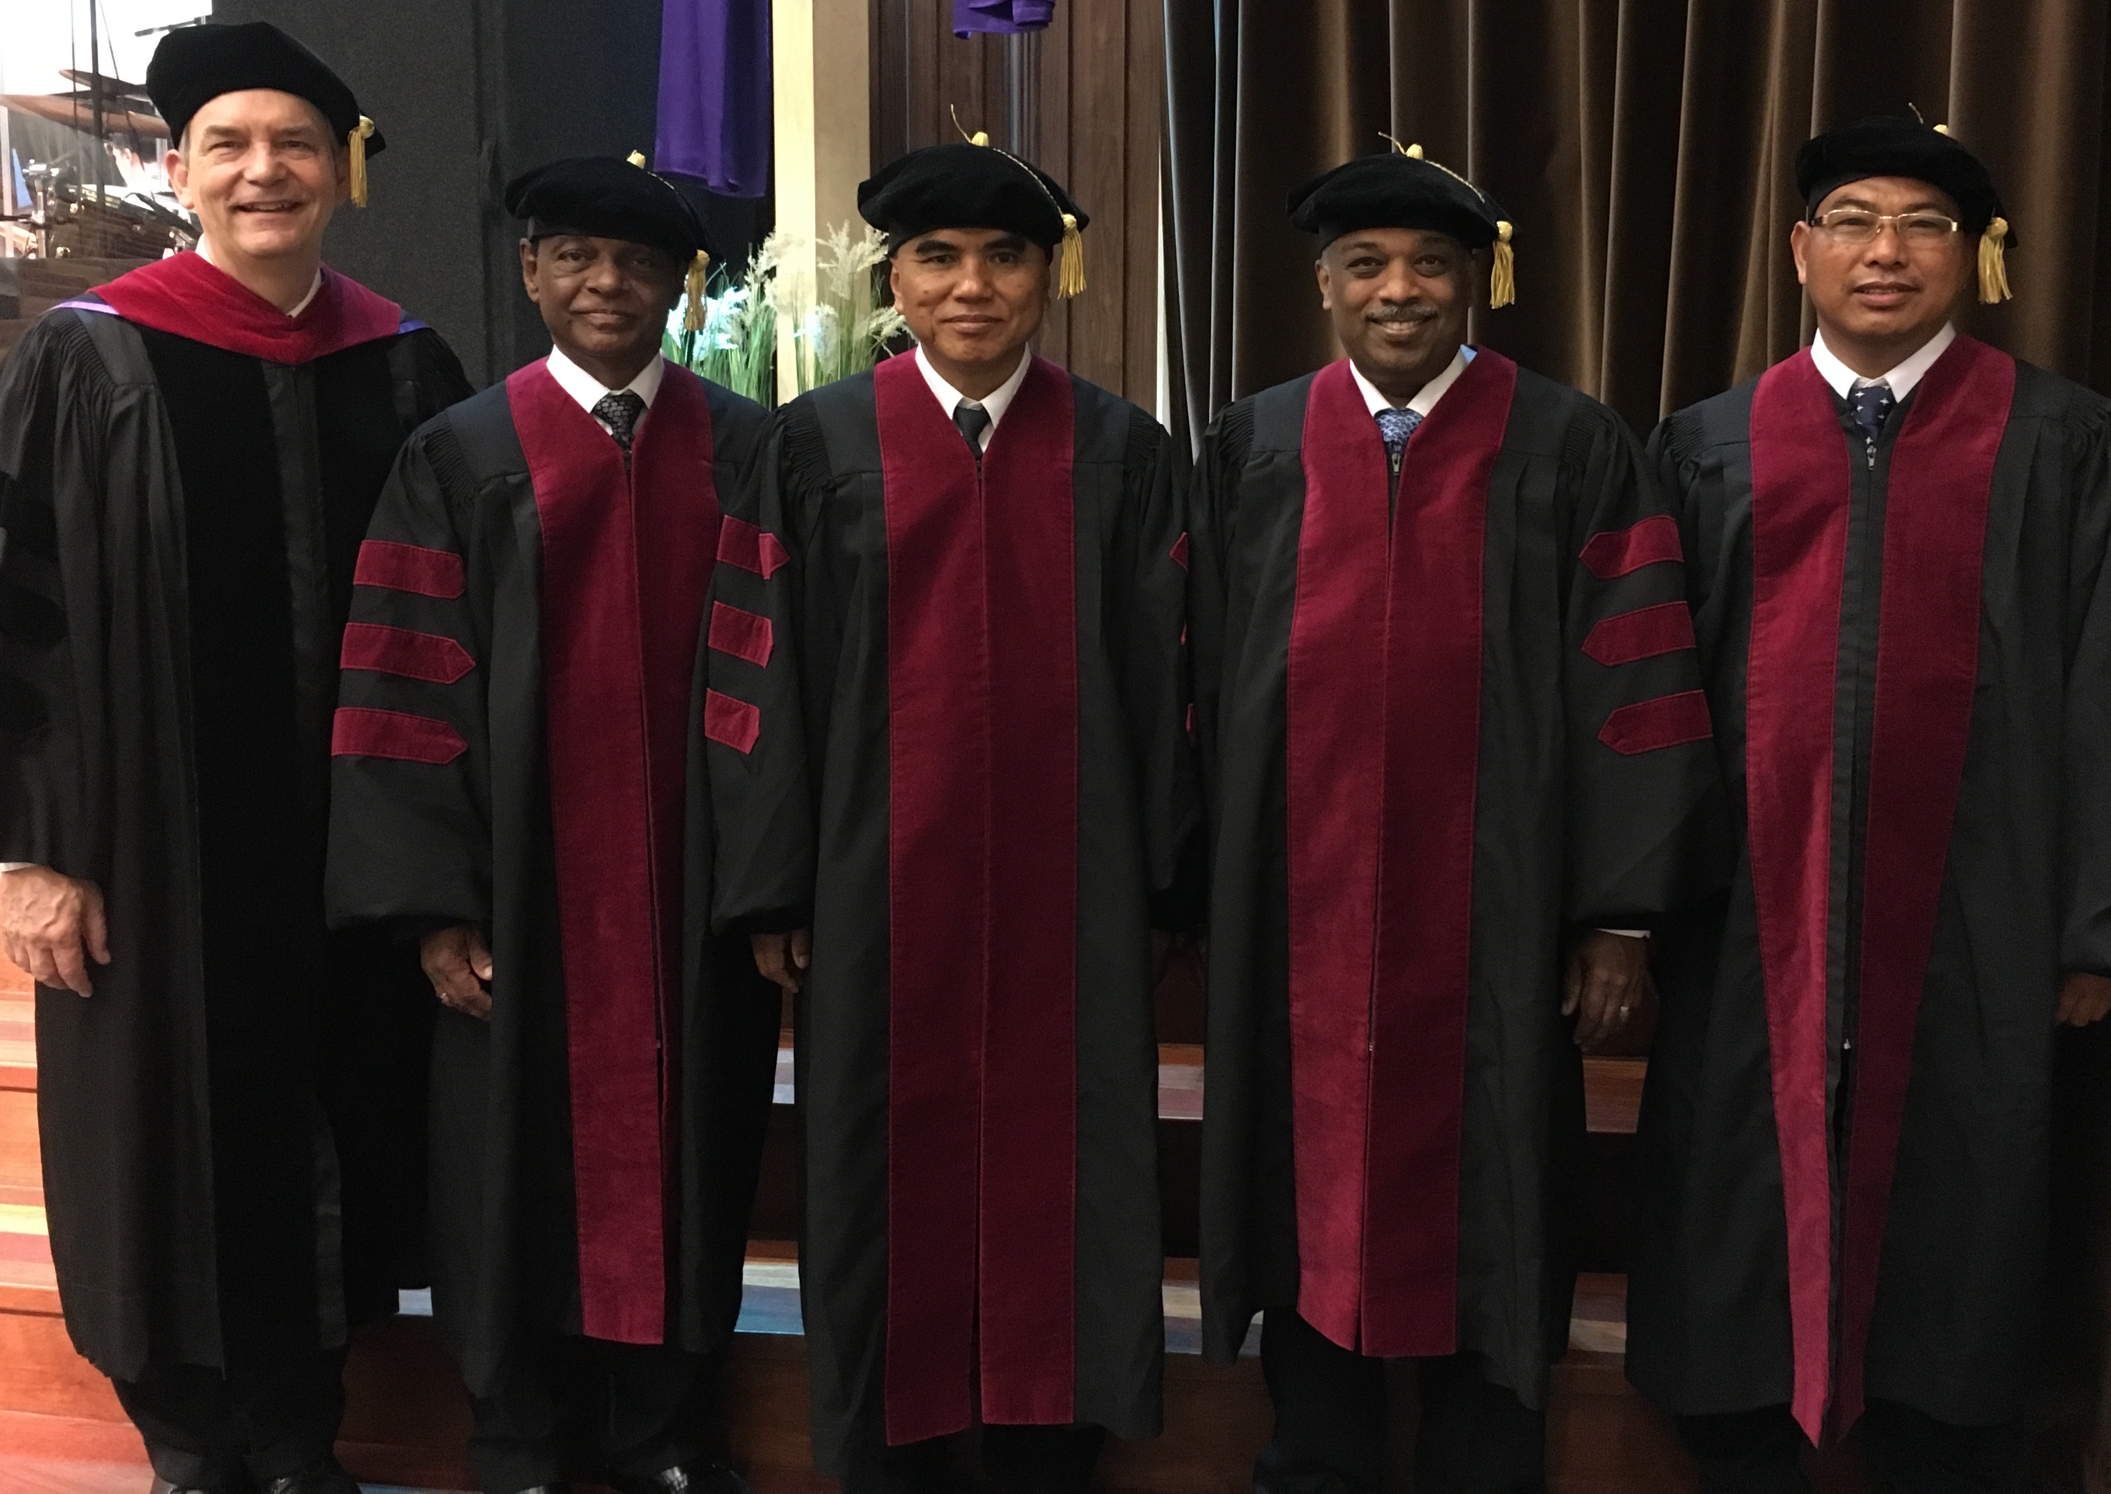
I directed the SBC Doctor of Ministry studies (DMin) from 2012-2021
Notes:
SBC trains about 50 seminary professors and pastors throughout Asia in English and Chinese. Generally each year about 5 of them received their Doctor of Ministry degree.

Slide 15
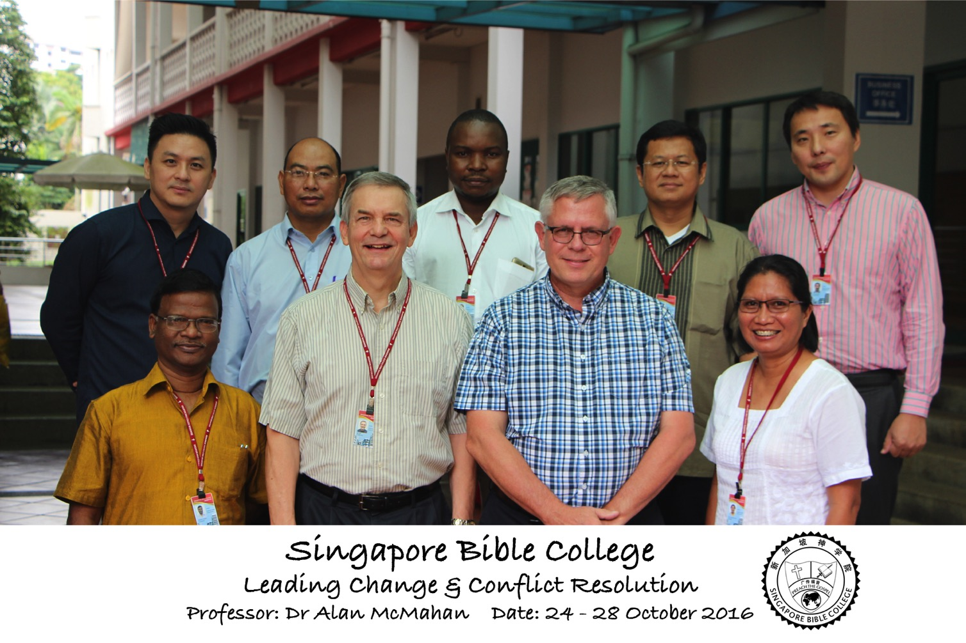
Leading Change & Conflict Resolution
(Dr. Alan McMahan Oct 2016)

Slide 16


Crossroads People • June 2021
UK
UNITED KINGDOM
RUSSIA
NETHERLANDS
MONGOLIA
ITALY
FRANCE
KOREA
HONG KONG
LEBANON
EGYPT
JAPAN
CHINA
MYANMAR
GERMANY
TAIWAN
CANADA
INDIA
USA
THAILAND
ETHIOPIA
MALAYSIA
ZIMBABWE
SOUTH AFRICA
PHILIPPINES
SINGAPORE
INDONESIA
CIC
AUSTRALIA
NEW ZEALAND
KENYA
Notes:
We actually have about 20% Indian at CIC, thanks to St. Thomas, who overcame his initial reluctance to witness for Jesus in India.
Our June 2021 church of 90 people stem from 16 different countries around the world: Australia (David & Fiona), China (Jianji), Egypt (Tamara), France (Valentin), Korea (Grace Kim), India (Cynthia), Indonesia (Rena), Kenya (Jacqueline Ngare), Nepal (Joshua Limbu), Netherlands (Toes), Singapore (Albina), South Africa (Melody Hertenberger), Taiwan (Maple), Thailand (Mae), UK (James & Gabi), USA (Jim & Jacqui).
This does not include people who have recently attended only once:
Nor does it include missionaries living back in their countries but still are members of CIC: Maple (Taiwan), Budmaa (Mongolia)
Previous: Canada (Gloria Lee), Ethiopia (Lele), Malaysia (Aston, Naomi), Netherlands (Dies & Desiree), Philippines (Micah), South Africa (Melody),

Slide 17
Courses Taught Since 1991
(English • Indonesian • Chinese)
Survey • The Bible…Basically
OT NT Bible Study
Backgrounds • Research & Writing
OT NT Geography
Theology • Creation • Jesus
Church • Spirit • Salvation • Future
Preaching
Homiletics 1 Homiletics 2
Notes:
I get to teach these leaders every book of the Bible in survey courses, plus backgrounds to both the OT and NT, three areas of theology, and how to preach.

Slide 18

Our Mission Organization…

Slide 19

Singapore Bible College Students
USA
MONGOLIA
JAPAN
KOREA
CHINA
HONG KONG
MYANMAR
INDIA
THAILAND
VIETNAM
PHILIPPINES
MALAYSIA
SINGAPORE
SRI LANKA
INDONESIA
SBC
Notes:
These faithful leaders are from about 25 countries who come to us in Singapore for masters and doctoral-level training. We train them to build into others back in their home countries.

Slide 20

PRECEPT LADIES BIBLE STUDY TEACHING
USA • Singapore • New Zealand • Holland

Slide 21


Thailand • Mongolia • Myanmar • Indonesia
Susan teaches SBC student wives also
Notes:
INTERVIEWER: And Susan, what ministries has the Lord granted you?
SUSAN: I have been teaching the wives of leaders at SBC. These 5 women come from 5 different nations!
SUSAN: I also lead the woman's Bible study at our church

Slide 22
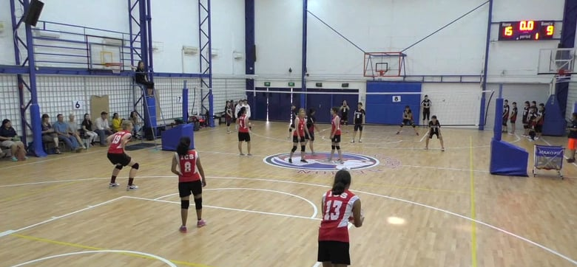
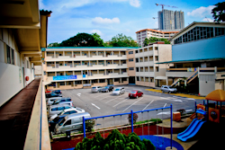
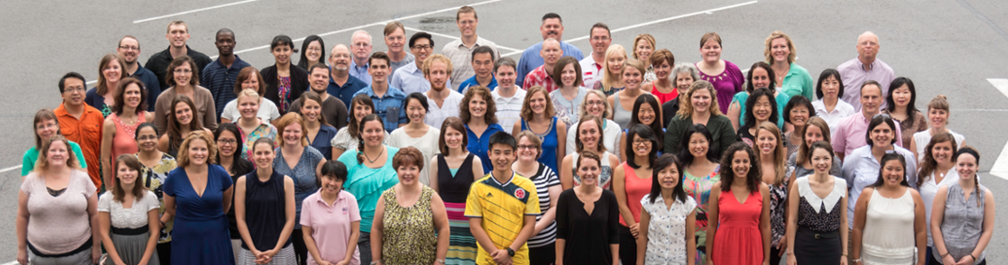
International Community School
(est. 1993)

Slide 23

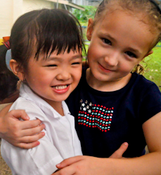


ICS now has over 400 students!
UK
SWEDEN
KOREA
SWITZERLAND
JAPAN
ITALY
USA
THAILAND
INDIA
MEXICO
ICS
VENUZELA
INDONESIA
BRAZIL
SOUTH AFRICA
AUSTRALIAN

Slide 24
Teaching 1994-2021
ISRAEL
MONGOLIA
JORDAN
KOREA
CHINA
NEPAL
MYANMAR
INDIA
THAILAND
VIETNAM
MALAYSIA
SRI LANKA
SINGAPORE
SBC
INDONESIA
Notes:
From 1997-Dec 2020 God has seen fit to grant me the privilege to train pastors in 12 other countries on 73 trips. Often pastors in the US team-teach with me on these trips. To help the poor, I avoid the wealthy countries where listeners can pay an honorarium but instead raise the funds to pay my own way and then teach for free.

Slide 25


NT Backgrounds link at BibleStudyDownloads.org
Get this presentation for free!
Notes:
NT Backgrounds (nb)

Slide 26
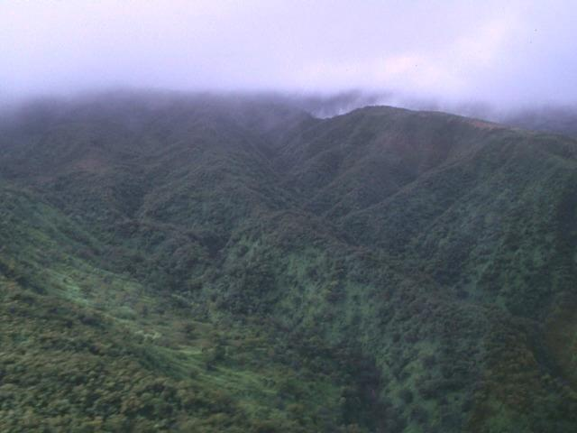
The Lord Reigns
The Lord reigns, the Lord reigns,
the Lord reigns let the earth rejoice
let the earth rejoice let the earth rejoice
Let the people be glad;
that our God reigns.
(repeat)

Slide 27
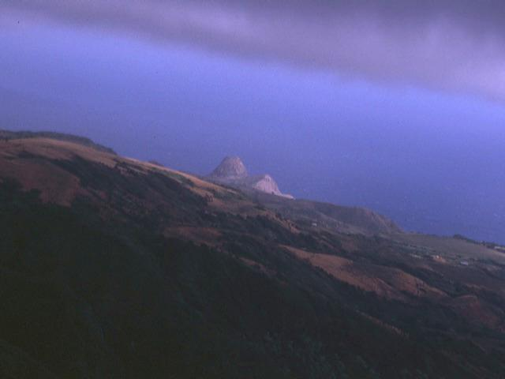
The Lord Reigns
The heavens declare His righteousness.
The people see His glory
For You, O Lord, are exalted
over all the earth
over all the earth.

Slide 28
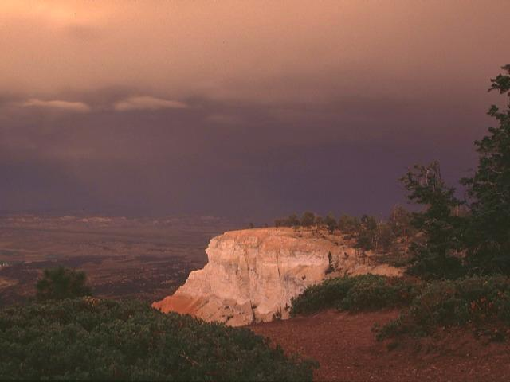
The Lord Reigns
The Lord reigns, the Lord reigns,
the Lord reigns let the earth rejoice
let the earth rejoice let the earth rejoice
Let the people be glad;
that our God reigns,
our God reigns,
our God reigns,
our God reigns.

Slide 29
Course Description
vii
A survey of biblical geography and political, socio-economic, religious, and literary developments of the intertestamental period that prepared for Christ's coming as well as factors in the first century that influenced the early church and affect us in our world mission today.

Slide 30

NTS vs. NTB
xv
Geography
Literary Context
NT Survey
  Author, date, argument
  Chronology of books
  Unique characteristics
Politics (History)
Religious Context
Socio-Economic Context

Slide 31
Course Objectives
vii
By the end of this course each student will be able to…
Show how the geography of Israel and the Roman world enables a better comprehension of the NT and the modern church's world mission.
Place the NT writings in their historical mould, which includes political, sociological (esp. economic), religious, and linguistic backgrounds for interpreting the NT and present society.
Show how cultural values and practices in Roman, Hellenistic, and Jewish societies aid understanding of the NT and find parallels in the church and society today.

Slide 32

Course Requirements
vii
Readings (33%)
Quizzes (33%)
Translation PPT (33%)

Slide 33
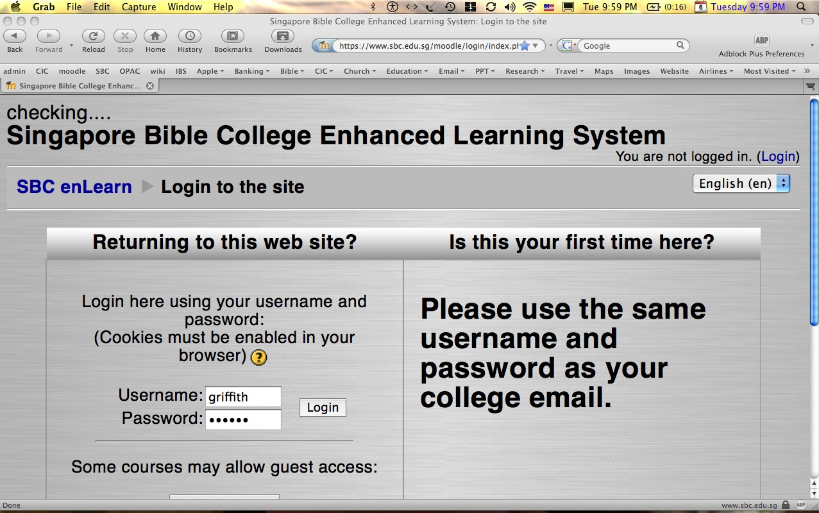
How to Get on Moodle…
1
Log on at sbc.edu.sg/moodle/login/index.php
Type your normal SBC username
Type normal SBC password
Click on the WNT course
Take your quiz or post a message

Slide 34


All Quizzes and Exams are Closed Book!

Slide 35
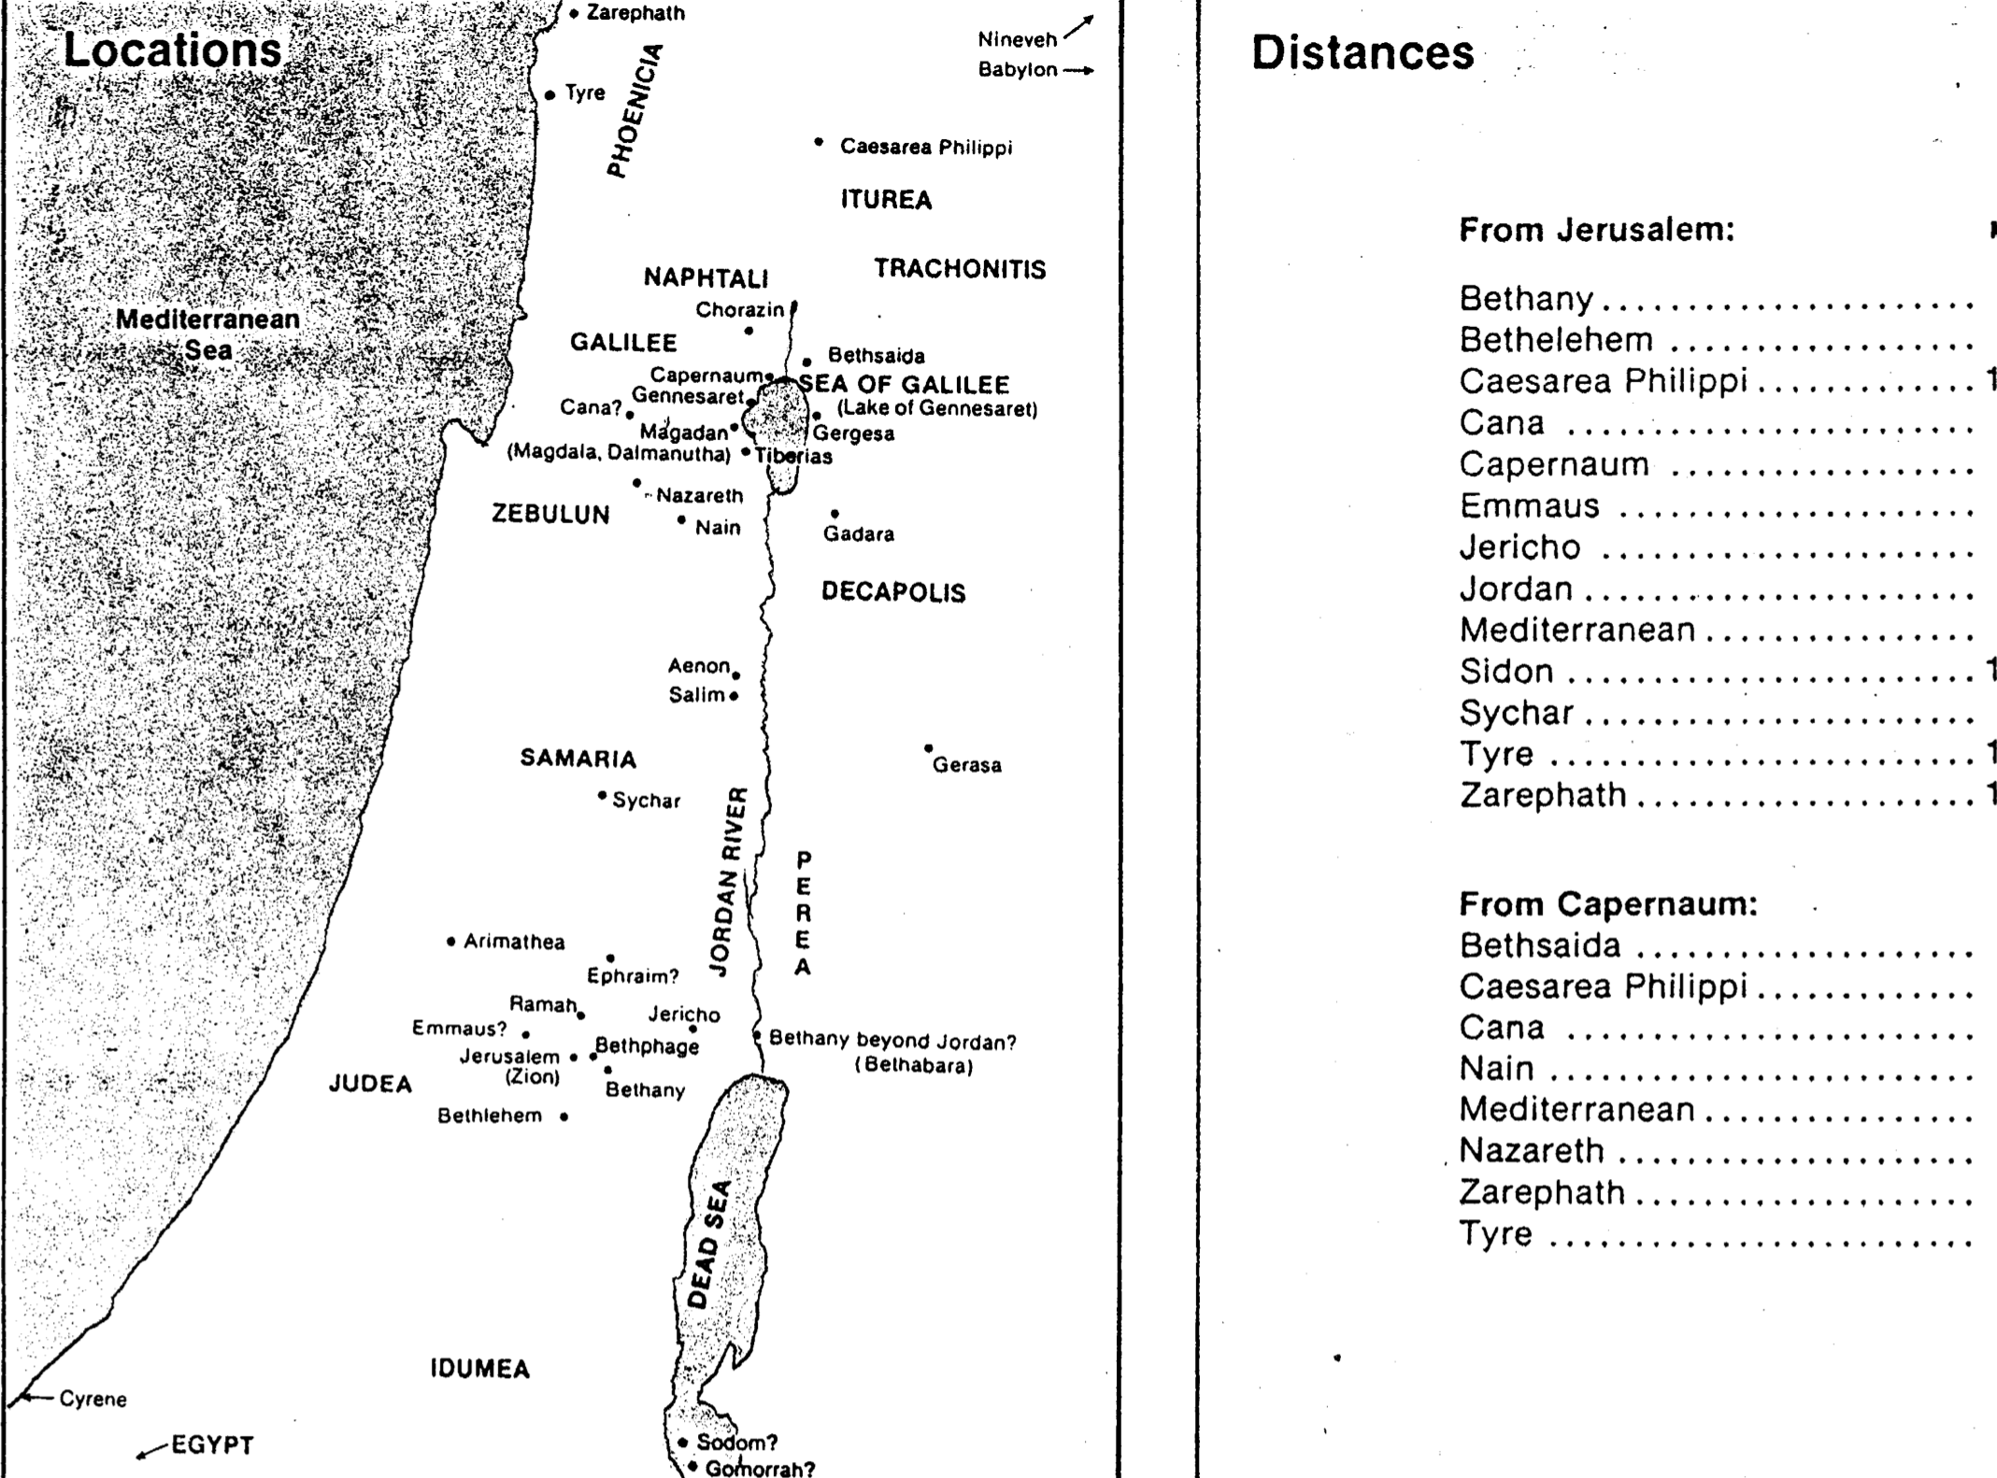
Quiz #1: Every Geographical Location in the Gospels
Distances Miles
From Jerusalem:
Bethany 2
Bethlehem 6
Caesarea Philippi 105
Cana 69
Capernaum 85
Emmaus 7
Jericho 15
Jordan 21
Mediterranean 40
Sidon 130
Sychar 31
Tyre 106
Zarephath 118
From Capernaum:
Bethsaida 6
Caesarea Philippi 27
Cana 16
Nain 22
Mediterranean 32
Nazareth 23
Zarephath 45
Tyre 37
2

Slide 36

Assignment File System

Slide 37

PowerPoint (945 slides)
Student Workbook (100 pages)
Teacher Script (400 pages)
TBB Materials
Completed in
English • Chinese • Hindi • Indonesian • Korean • Malay • Mongolian • Russian • Spanish
A Presentation of The Bible…Basically Ministries International Inc. Fort Worth, Texas
BibleBasically.org
©2004 TBBMI
8.0.01.
04

Slide 38
Other Matters
7
Copying Class Notes
Contacting Me
Mobile number: +962 7 9725 6061
My office hours are after chapel
Email: drrickgriffith@gmail.com
Let's have lunch too!

Slide 39
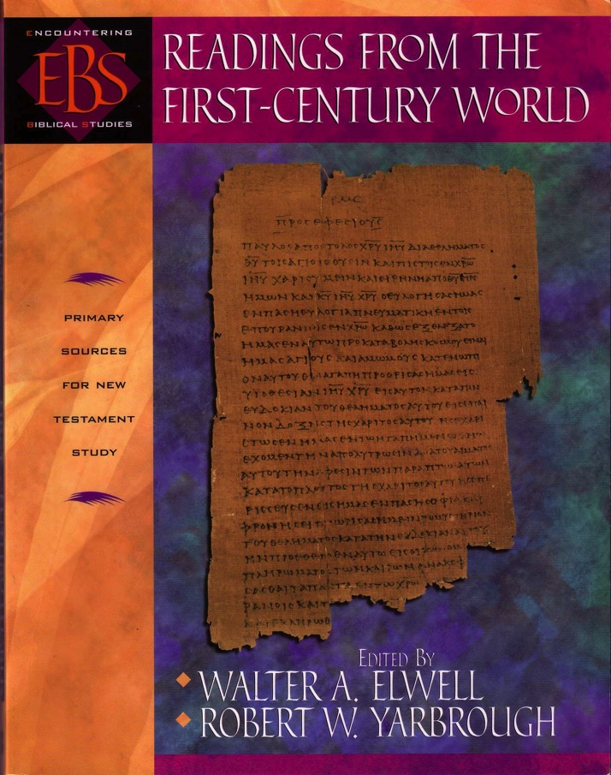
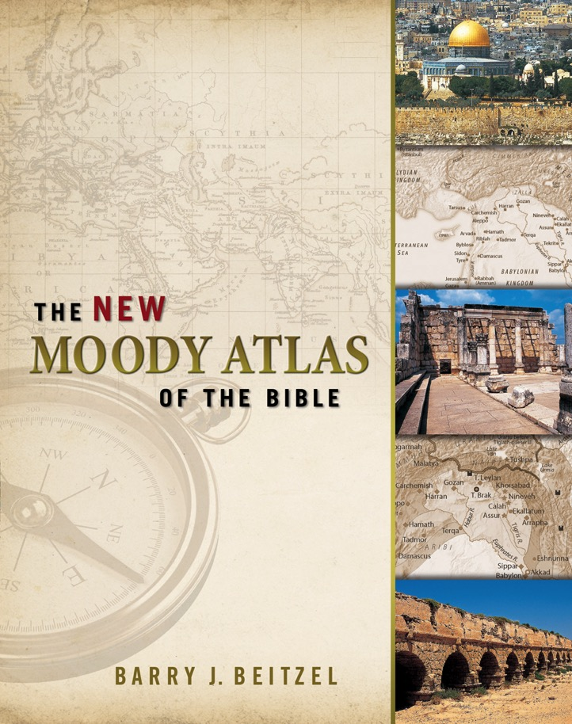
Our Main Texts
You will read mostly primary sources

Slide 40
NT Backgrounds link at BibleStudyDownloads.org
Get this presentation for free!
Notes:
NT Backgrounds (nb)

